Slide 1

Dynamic Generation of Modular Industrial Plant Visualizations
Weekly Meeting 14
Miguel Romero Karam

Slide 2
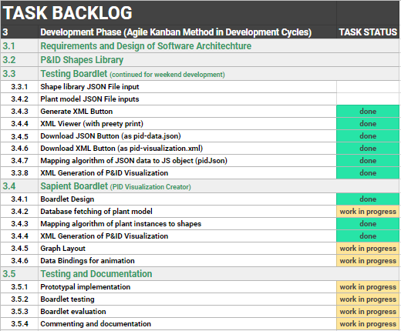
Task Backlog – Overview Overview of tasks: Week 14

Slide 3
Task Backlog – Overview Overview of tasks: Week 14

Slide 4
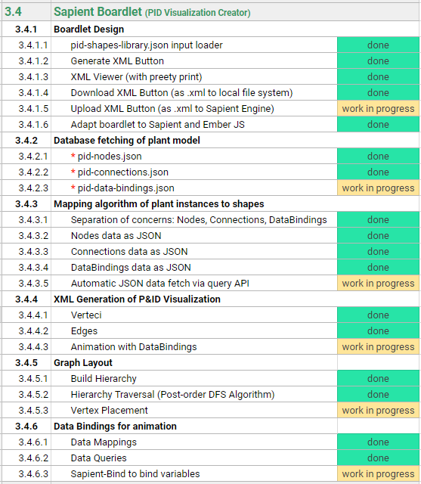
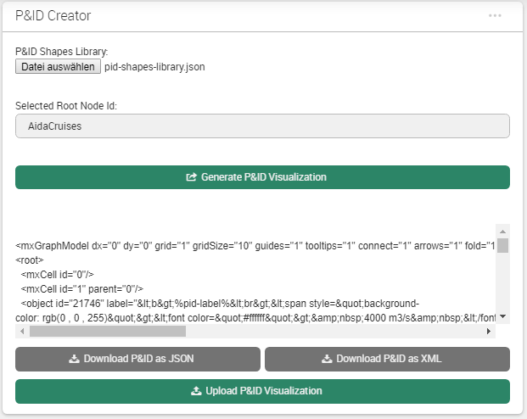
Sapient Boardlet Weekly Sprint 14

Slide 5
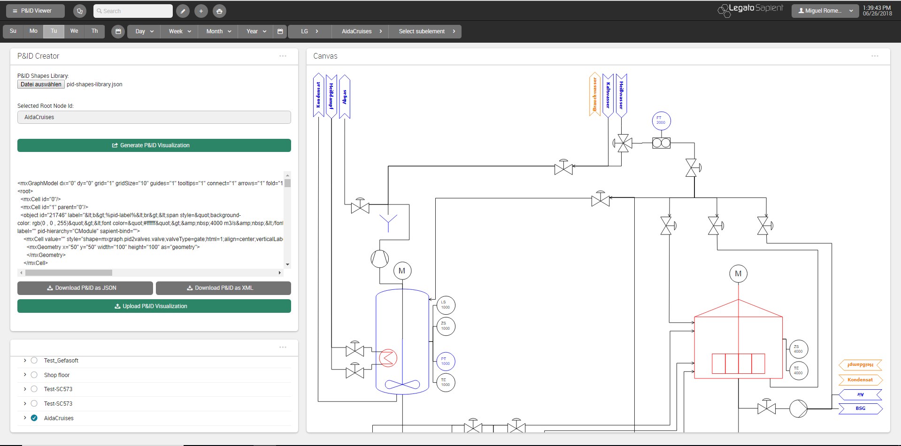
P&ID Viewer - Dashboard

Slide 6
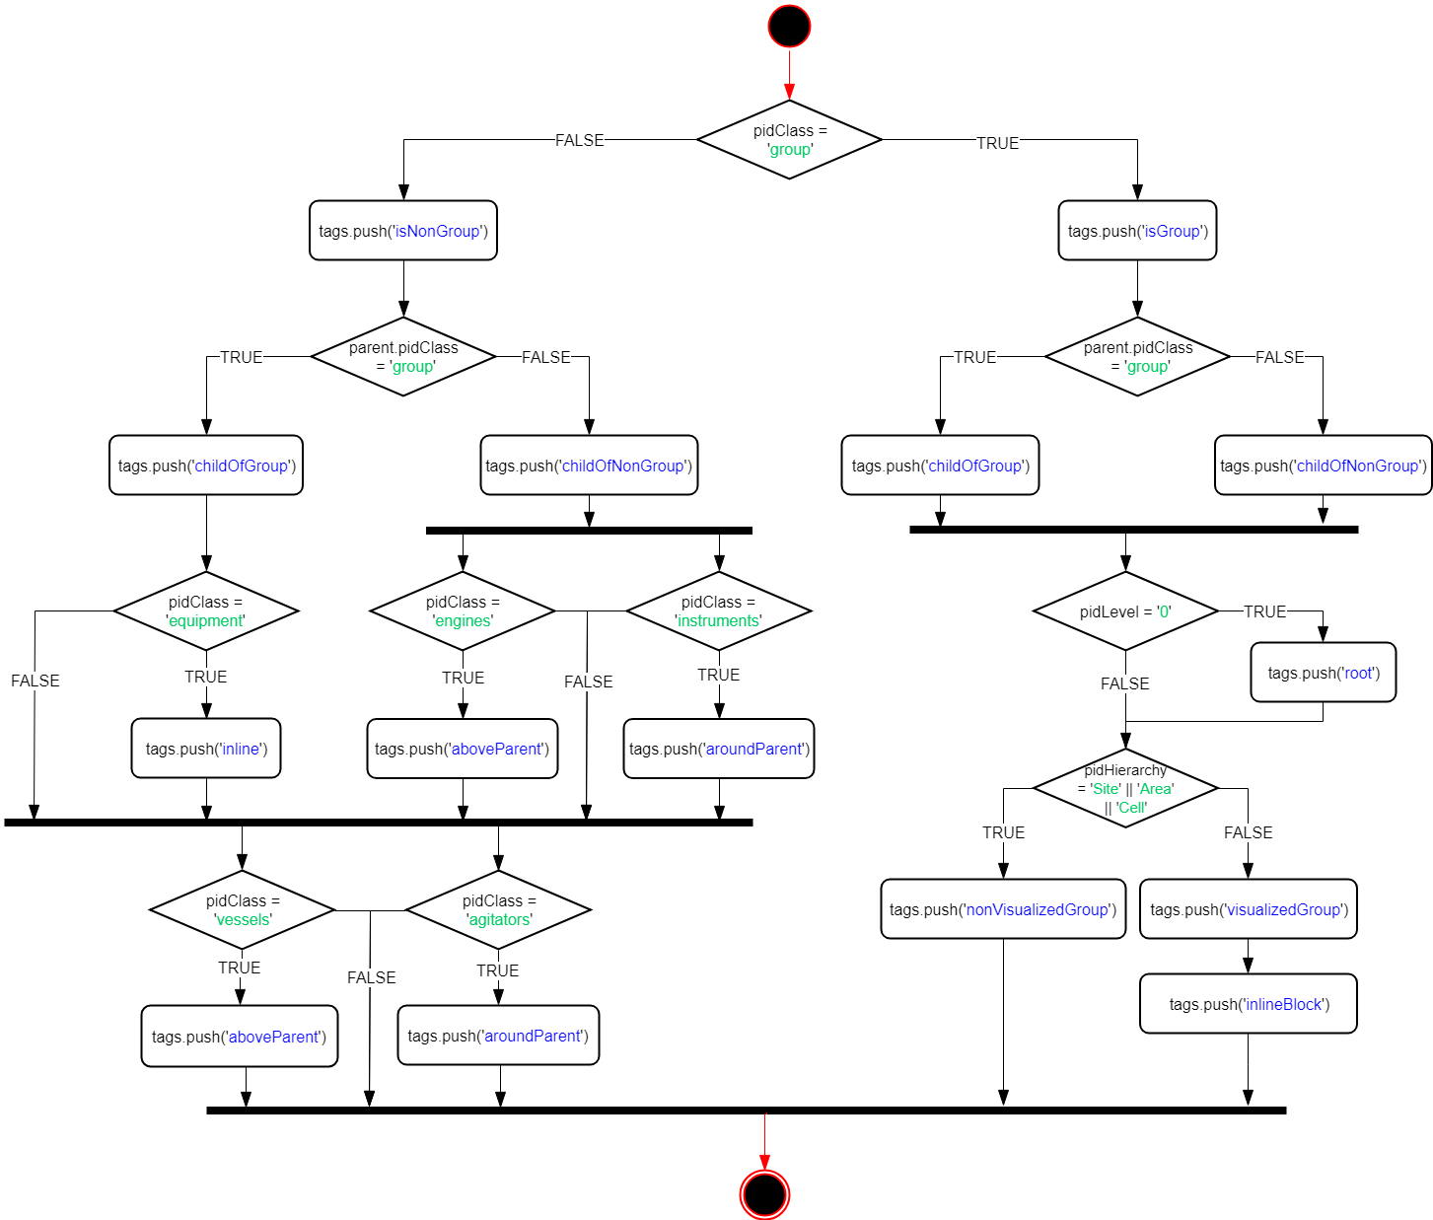
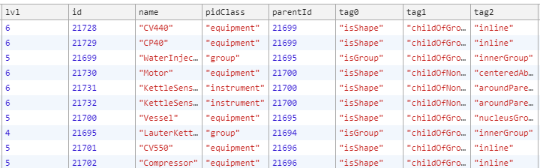
Constraint Specification Rules
Positioning Rules based on shape attributes:
ÄNDERUNGEN HIEEEEEER
Tags:

Slide 7
vertexPlacement() Example:
forEach vertex in pidVertices:
if (not group):
calculate cell area
store cell area
position current vertex:
get previous vertex position (x, y values)
apply positioning rules
set current vertex position
update value of previous x, y values
else if (group):
sum areas of contained cells

Slide 8
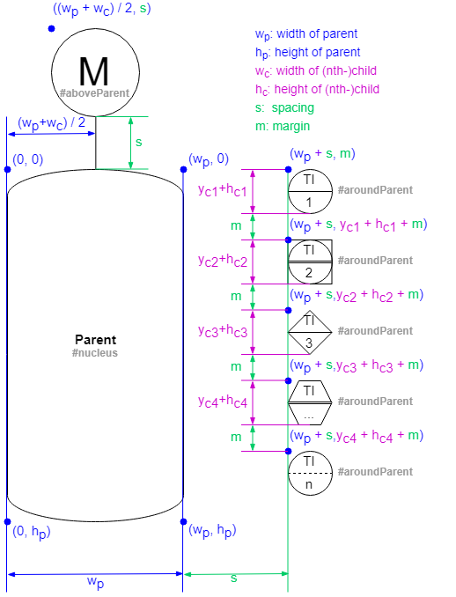
vertexPlacement() Example:

Slide 9
simplifyEdges() Example:
PSEUDOCODE FOR SIMPLIFYEDGES FUNCTION
AND ALSO FOTO (YA LA HICE)
forEach vertex in pidVertices:
if (not group):
calculate cell area
store cell area
position current vertex:
get previous vertex position (x, y values)
apply positioning rules
set current vertex position
update value of previous x, y values
else if (group):
sum areas of contained cells

Slide 10
Issues and Challenges Weekly Sprint 14
Stillstand beim vertexPlacement Algorithmus
Alles wofür es eine bestimmte Logik dahinter gibt, wird schon entsprechend dieser Logik platziert.
Nich viel mehr Logik um das Platzierungsalgorithmus in wenig Zeit noch zu verbessern.
Vorteile:
Konzentration auf Data-bindings (dynamisierung)
Verteci schon ziemlich gut platziert und edges vereinfacht
Verbesserungsmöglichkeiten direkt im draw.io (Drag&Drop)
Nachteile:
Platzierung is was das Endergebniss: die Visualisierung “schön” macht
Arbeit und Aufwand die hinter der Visualisierung steht sieht man nicht
Kann zu enttäuschende Schlussfolgerungen führen.
Animations via sapient-bind
Define sapient-bind JSON structure
Function to create data-bindings with data fechted from database
Boardlet Design (niedrigste Priöritäat)
Upload button
Until now, no way of uploading files from client to the file system found (because of security issues)
Progress Bar

Slide 11
Previous Sprint – ToDos Weekly Sprint 14
Boardlet Design
Fix floating buttons (side-by-side)
Design of root-node-selection input field
Fix query of siblings when selecting one root node
Build Hierarchy Function
Fix to start from selected root node (to work out for multiple)
Database queries
Connect remaining tables to repository with LC2 (instructions in daily-routine notes)
getData() generic Function
pidRootNode name query (to display in input field on updateInput())
pidNodes query
pidConnections query
Process Variables query
Animations via sapient-bind
Documentation and Commenting
Modularization of code
JsDocs
Graphing Algorithm

Slide 12
Next Sprint – ToDos Weekly Sprint 14
Vertex placement algorithm
Continuous improvement
Animations via sapient-bind
Define sapient-bind JSON structure
Function to create data-bindings with data fechted from database
Upload button
Until now, no way of uploading files from client to the file system found (because of security issues)

Slide 13
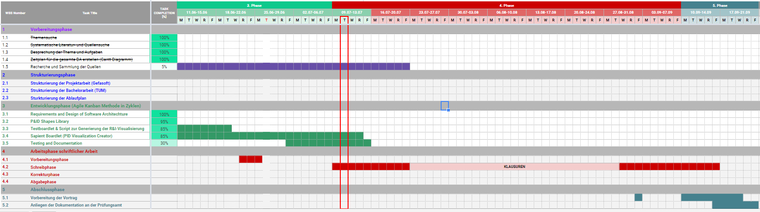
Project – Overview Overview of tasks: Week 10

